Slide 1

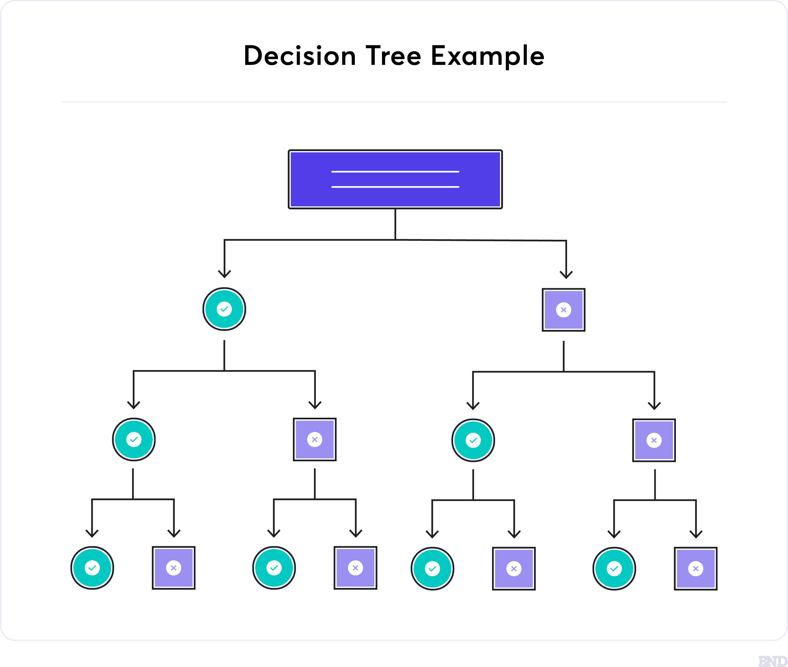
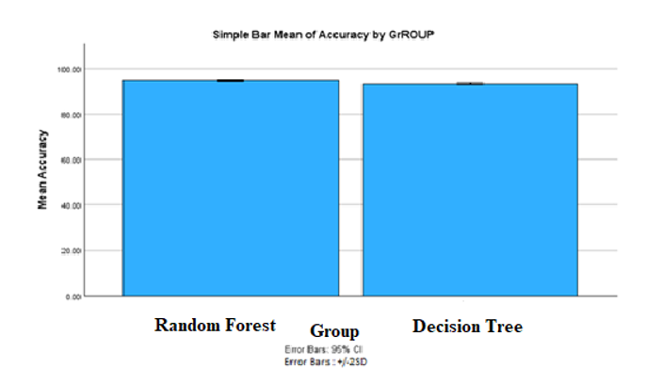
Name: Mr. S. Lakshmikanth
Register no: 192011496L
Guide: Dr. T. Suresh Balakrishnan
Intrusion System Detection System Using Novel Random Forest Compared to Decision Tree
INTRODUCTION
IDS monitors network traffic, detecting and alerting on potential security breaches via analysis of abnormal behavior.
IDS analyzes network activity to distinguish between legitimate and malicious behavior, primarily focusing on detecting and alerting potential security breaches.
IDS uses ensemble learning, optimization algorithms, and advanced machine learning techniques to boost performance.
Studies utilize Novel Random Forests and deep neural networks to boost IDS accuracy, facing challenges of false alarms and adaptation to diverse network environments.
Fig 1. Decision Tree
MATERIALS AND METHODS
Data Collection
Feature Selection
Model Training
Model Testing
Model Evaluation
Data Preprocessing
RESULTS
Novel Random Forest exhibits higher average accuracy (94.90%) compared to Decision Tree (93.72%) in the study
Statistical analysis confirms Novel Random Forest's accuracy superiority over Decision Tree, supported by independent sample T-test.
Novel Random Forest outperforms Decision Tree in handling large datasets with higher accuracy.
It enhances robustness by reducing overfitting through ensemble learning
Fig 2. Analysis for Random Forest and Decision Tree
DISCUSSION AND CONCLUSION
Approach: The study proposes an effective Intrusion Detection System by selecting significant features from the NSL-KDD dataset using a classification system derived from Novel Random Forest , aiming to reduce learning time and memory required.
Feature Selection Strategy: Utilizing selective multinomial Naive Bayes and filtering experiments, the paper offers a network IDS approach, demonstrating efficiency and low positive error rates.
Paper examines how deep learning, used in safety-critical contexts, faces challenges from adversarial examples, reviewing discovery, generation, and classification methods.
Novel Random Forest surpasses Decision Tree in accuracy (94.90% vs. 93.72%), despite longer training time, with Decision Trees suggested for mitigating uncommon system traffic patterns.
BIBLIOGRAPHY
Ahmim et al. (n.d.) : Hierarchical IDS based on Random Forest and rules.
Alamiedy et al. (2020)**: Anomaly-based IDS using Grey Wolf Optimization.
Besharati et al. (2018): LR-HIDS for cloud environments.
Chen et al. (2021) : Intrusion detection model based on bagged tree classifiers.
Chittora et al. (2022) : Experimental analysis of earthquake prediction using ML classifiers.

